Slide 1
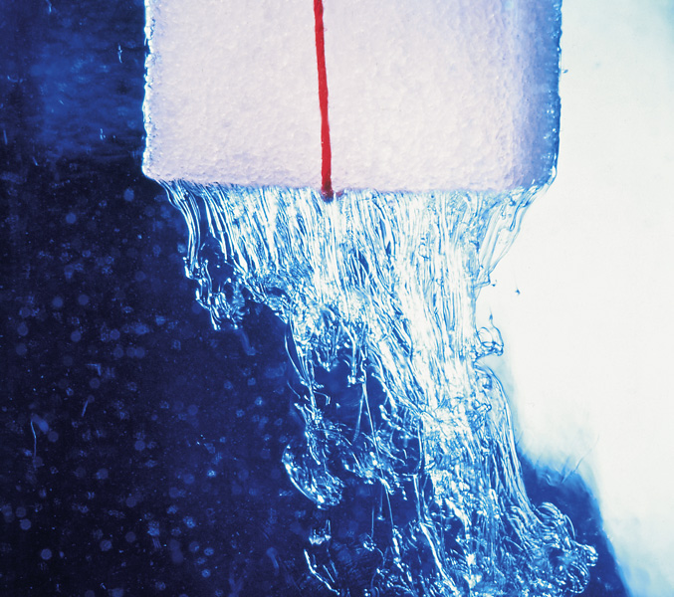
Chapter 14: Solutions and Their
Physical Properties
General Chemistry
Principles and Modern Applications
Petrucci • Harwood • Herring
8th Edition
Philip Dutton
University of Windsor, Canada
N9B 3P4
Prentice-Hall © 2002
Notes:
Antifreeze must be added to water in coolant systems in cold climates to lower the freezing point. We will learn why.
Dehydrated individuals must be rehydrated with a solution of the correct osmotic pressure.
Emphasis in this chapter will be on describing solution phenomena and their appl,ications and explaining these phenomena at the molecular level.

Slide 2
Contents
14-1 Types of Solutions: Some Terminology
14-2 Solution Concentration
14-3 Intermolecular Forces and the Solution Process
14-4 Solution Formation and Equilibrium
14-5 Solubilities of Gases
14-6 Vapor Pressure of Solutions
14-7 Osmotic Pressure
Notes:
Lewis theory has shortcomings. It does not explain conduction or semiconductors. More sophisticated approaches are required.
Hybridization. Molecular orbitals from atomic orbitals.

Slide 3
Contents
14-8 Freezing-Point Depression and Boiling-Point Elevation of Nonelectrolyte solutions.
14-9 Solutions of Electrolytes
14-10 Colloidal Mixtures
Focus on Chromatography
Notes:
Lewis theory has shortcomings. It does not explain conduction or semiconductors. More sophisticated approaches are required.
Hybridization. Molecular orbitals from atomic orbitals.

Slide 4
13-1 Types of Solution:
Some Terminology
Solutions are homogeneous mixtures.
  Uniform throughout.
Solvent.
  Determines the state of matter in which the solution exists.
  Is the largest component.
Solute.
  Other solution components said to be dissolved in the solution.

Slide 5
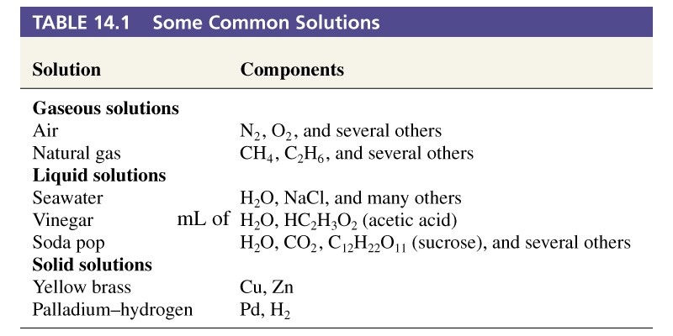
Table 14.1 Some Common Solutions
Notes:
Liquid solutions are most common.
Solid solutions – alloys

Slide 6
14-2 Solution Concentration.
Mass percent. (m/m)
Volume percent. (v/v)
Mass/volume percent. (m/v)
Isotonic saline is prepared by dissolving 0.9 g of NaCl in 100 mL of water and is said to be:
0.9% NaCl (mass/volume)

Slide 7
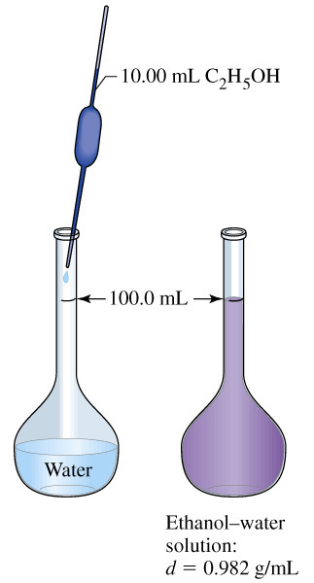
10% Ethanol Solution (v/v)

Slide 8
ppm, ppb and ppt
Very low solute concentrations are expressed as:
ppm: parts per million (μg/g, mg/L)
ppb: parts per billion (ng/g, μg/L)
ppt: parts per trillion (pg/g, ng/L)
note that 1.0 L  1.0 g/mL = 1000 g
ppm, ppb, and ppt are properly m/m or v/v.

Slide 9
Mole Fraction and Mole Percent
Amount of component i (in moles)
Total amount of all components (in moles)
χ =
χ₁ + χ₂ + χ₃ + …χ_{n} = 1
Mole % i = χ_{i}  100%

Slide 10
Molarity and Molality
Amount of solute (in moles)
Volume of solution (in liters)
Molarity (M) =
Amount of solute (in moles)
Mass of solvent (in kilograms)
Molality (m) =
Notes:
Molality is independent of temperature and is proportional to mole fraction at low concentrations.

Slide 11
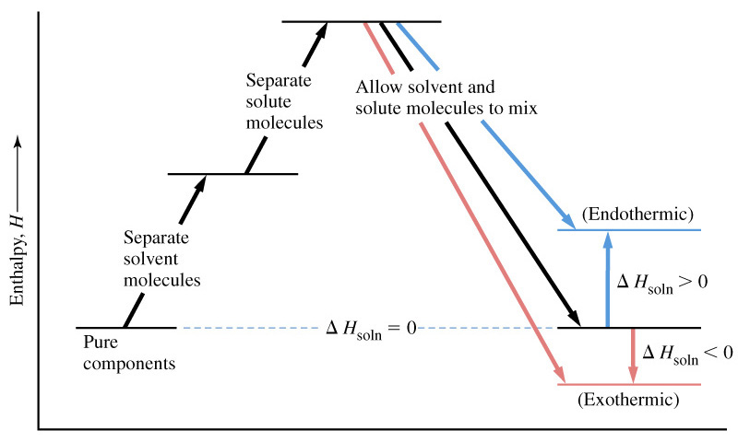
14-3 Intermolecular Forces and the Solution Process
ΔH_{b}
ΔH_{c}
ΔH_{a}

Slide 12
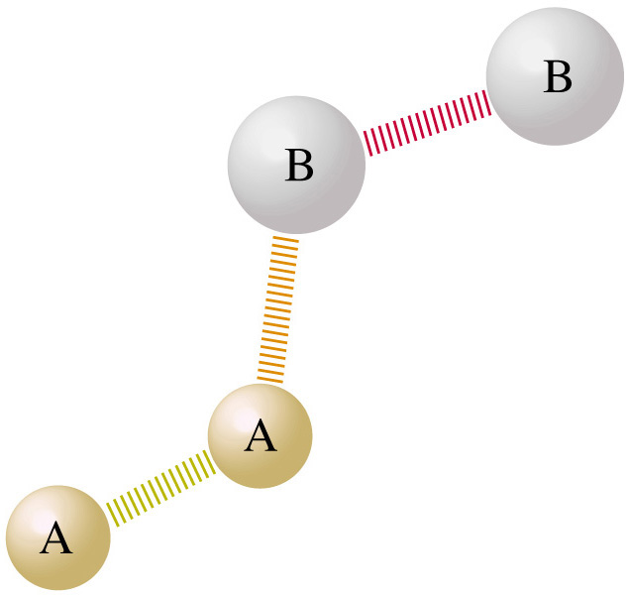
Intermolecular Forces in Mixtures
Magnitude of ΔH_{a}, ΔH_{b}, and ΔH_{c} depend on intermolecular forces.
Ideal solution
  Forces are similar between all combinations of components.
ΔH_{soln} = 0

Slide 13
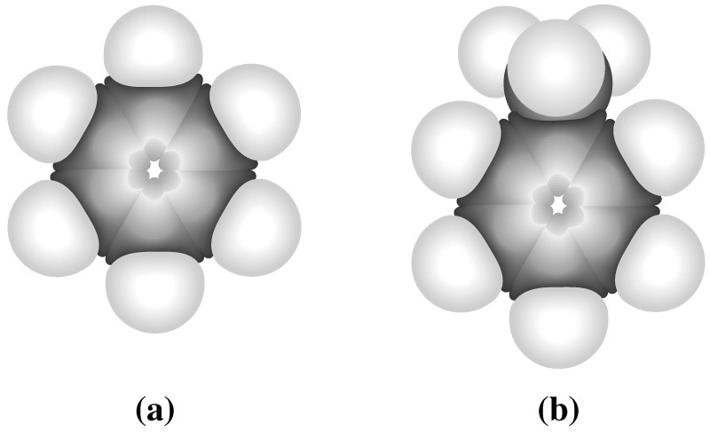
Ideal Solution

Slide 14
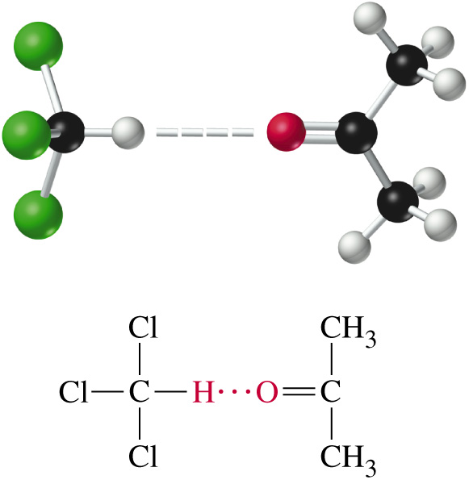
Non-ideal Solutions
Adhesive forces greater than cohesive forces.
ΔH_{soln} < 0
Notes:
Forces between unlike molecules exceed those between like molecules

Slide 15
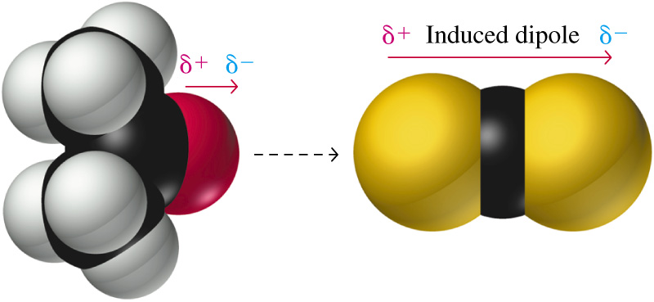
Non-ideal Solutions
Adhesive forces are less than cohesive forces.
At the limit these solutions are heterogeneous.
ΔH_{soln} > 0
Notes:
Acetone interacts with itself through dipole-dipole interactions. Acetone and CS₂ interact through dipole-induced dipole interactions, this is a weaker intermolecular interaction.

Slide 16
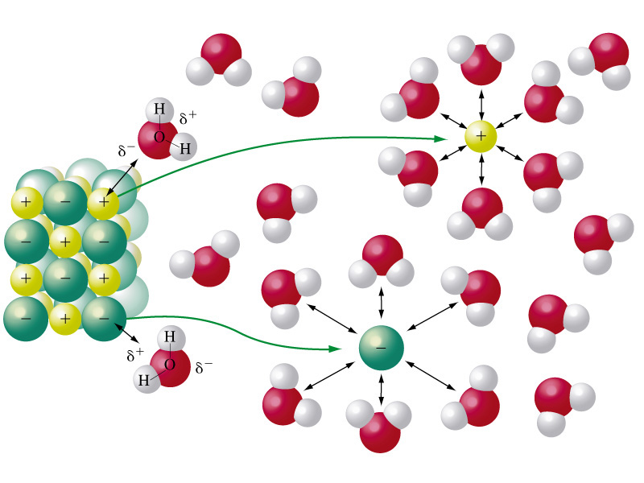
Ionic Solutions

Slide 17
Hydration Energy
NaCl(s) → Na⁺(g) + Cl⁻(g) ΔH_{lattice} > 0
Na⁺(g) + xs H₂O(l) → Na⁺(aq) ΔH_{hydration} < 0
Cl⁻(g) + xs H₂O(l) → Cl⁻(aq) ΔH_{hydration} < 0
ΔH_{soln} > 0 but ΔG_{solution} < 0

Slide 18
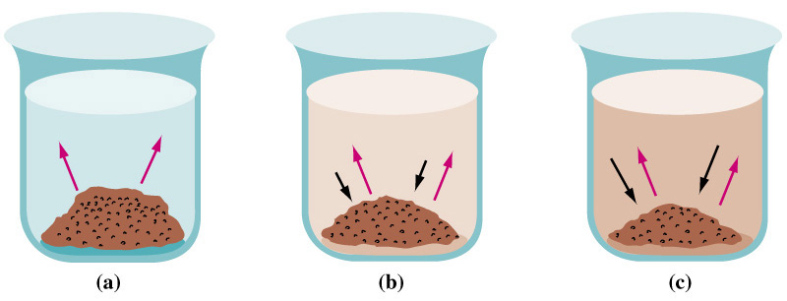
14-4 Solution Formation and Equilibrium
saturated

Slide 19
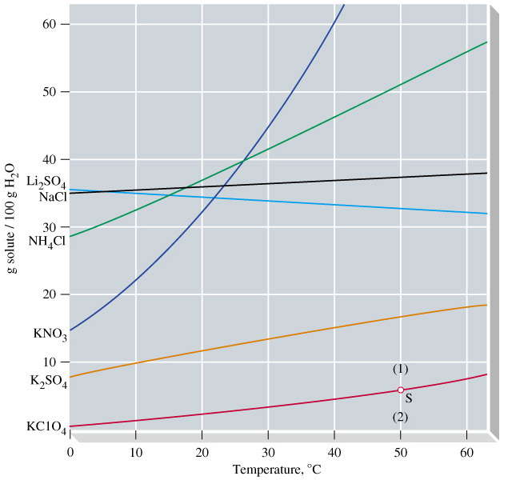
Solubility Curves
Supersaturated Unsaturated
Notes:
Discuss recrystallization
Solubility as a function of temperature.

Slide 20
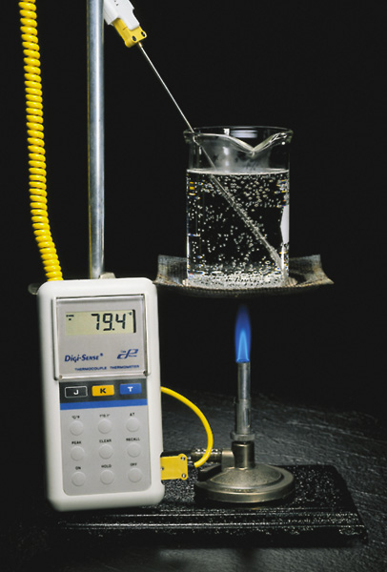
14-5 Solubility of Gases
Most gases are less soluble in water as temperature increases.
In organic solvents the reverse is often true.
Notes:
Dissolved air is realeased as water is heated, even well below the boiling point of water.

Slide 21
Henry’s Law
Solubility of a gas increases with increasing pressure.
C = k P_{gas}
C
23.54 mL
k =
=
= 23.54 ml N₂/atm
P_{gas}
1.00 atm
C
100 mL
P_{gas} =
=
= 4.25 atm
k
23.54 ml N₂/atm

Slide 22
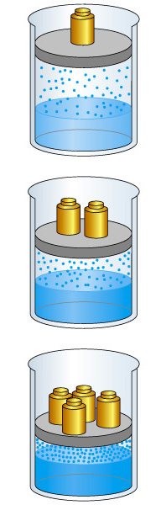
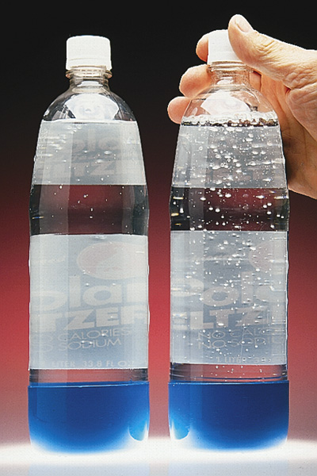
Henry’s Law

Slide 23
14-6 Vapor Pressures of Solutions
Roault, 1880s.
  Dissolved solute lowers vapor pressure of solvent.
  The partial pressure exerted by solvent vapor above an ideal solution is the product of the mole fraction of solvent in the solution and the vapor pressure of the pure solvent at a given temperature.
  P_{A} = χ_{A} P°
A

Slide 24
Example 14-6
Predicting vapor pressure of ideal solutions.
The vapor pressures of pure benzene and toluene at 25°C are 95.1 and 28.4 mm Hg, respectively. A solution is prepared in which the mole fractions of benzene and toluene are both 0.500. What are the partial pressures of the benzene and toluene above this solution? What is the total vapor pressure?
Balanced Chemical Equation:
  P_{benzene} = χ_{benzene} P°_{benzene} = (0.500)(96.1 mm Hg) = 47.6 mm Hg
  P_{toluene} = χ_{toluene} P°_{toluene} = (0.500)(28.4 mm Hg) = 14.2 mm Hg
  P_{total} = P_{benzene} + P_{toluene} = 61.8 mm Hg

Slide 25
Example 14-7
Calculating the Composition of Vapor in Equilibrium with a Liquid Solution.
What is the composition of the vapor in equilibrium with the benzene-toluene solution?
Partial pressure and mole fraction:
  χ_{benzene} = P_{benzene}/P_{total} = 47.6 mm Hg/61.89 mm Hg = 0.770
  χ_{toluene} = P_{toluene}/P_{total} = 14.2 mm Hg/61.89 mm Hg = 0.230

Slide 26
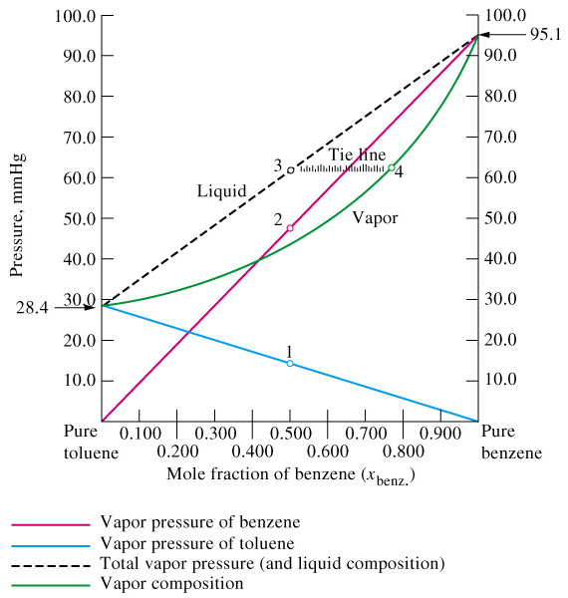
Liquid-Vapor Equilibrium
Notes:
The vapor phase is richer in the more volatile component.

Slide 27
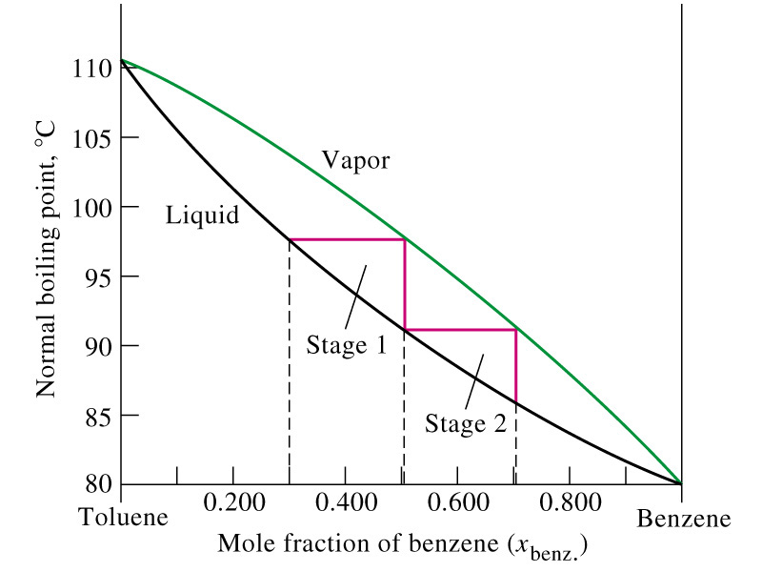
Fractional Distillation

Slide 28
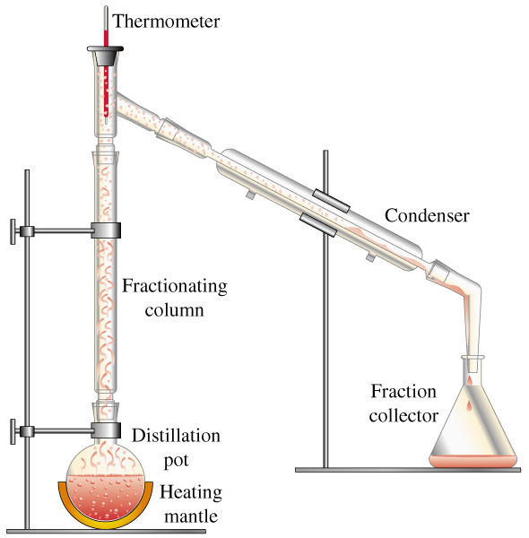
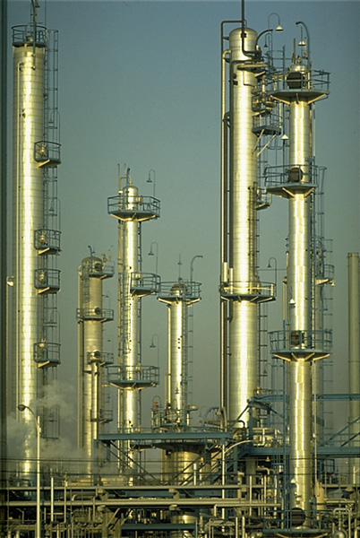
Fractional Distillation

Slide 29
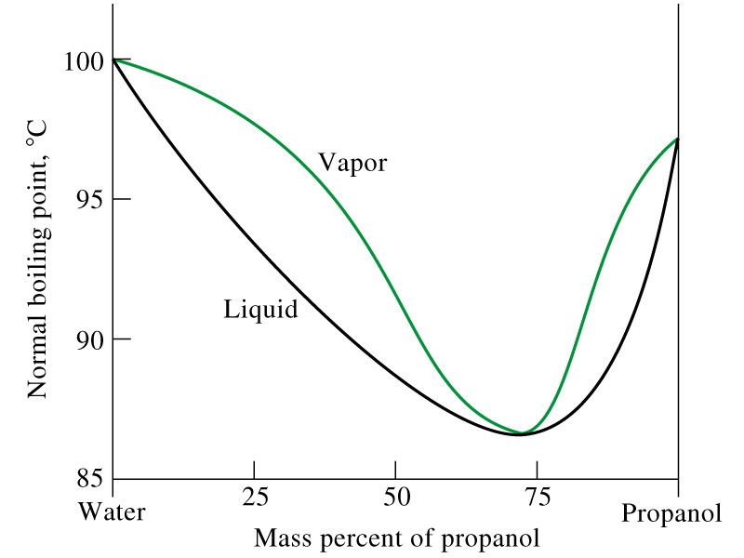
Non-ideal behavior
Notes:
For example chloroform-carbon disulfide mixtures have lower vapor pressure than predicted. Non-ideal behavior.

Slide 30
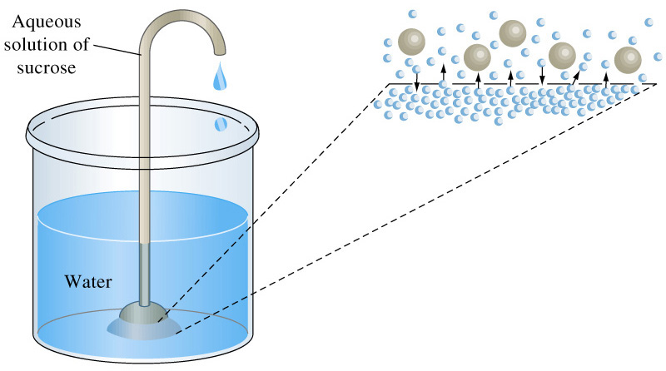
14-7 Osmotic Pressure
Notes:
Semipermeable membrane
Water flows from the low concentration of solute side to the high side to reduce the solute concentration. This causes osmotic pressure. It does not depend on the solute, but depends on the number of particles of solute. This is a COLLIGATIVE property.

Slide 31
Osmotic Pressure
For dilute solutions of electrolytes:
πV = nRT
n
π = RT
= M RT
V

Slide 32
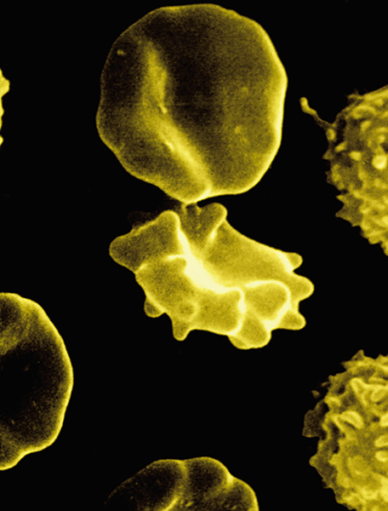
Osmotic Pressure
Hypertonic > 0.92% m/V
crenation
Isotonic Saline 0.92% m/V
Hypotonic > 0.92% m/V
rupture

Slide 33
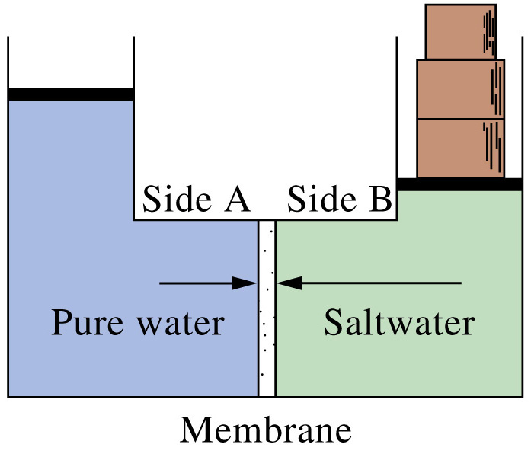
Reverse Osmosis - Desalination

Slide 34
14-8 Freezing-Point Depression and Boiling Point Elevation of Nonelectrolyte Solutions
Vapor pressure is lowered when a solute is present.
  This results in boiling point elevation.
  Freezing point is also effected and is lowered.
Colligative properties.
  Depends on the number of particles present.

Slide 35
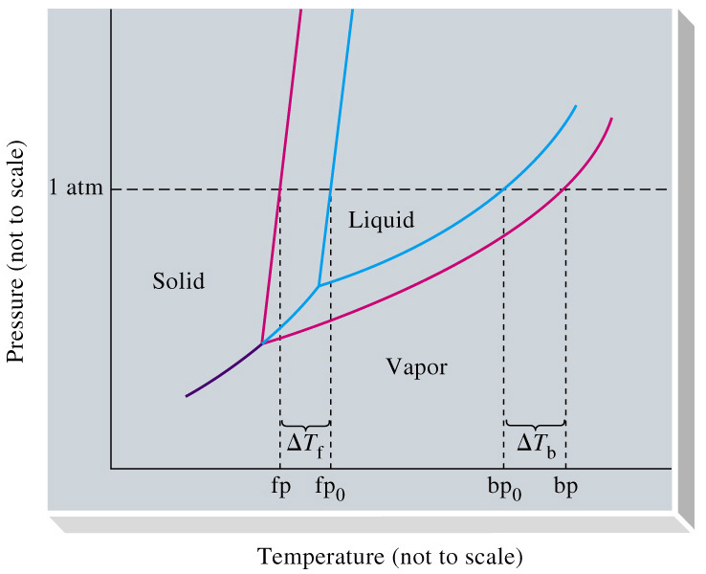
Vapor Pressure Lowering
ΔT_{f} = -K_{f}  m
ΔT_{b} = -K_{b}  m
Notes:
m is solute molality

Slide 36
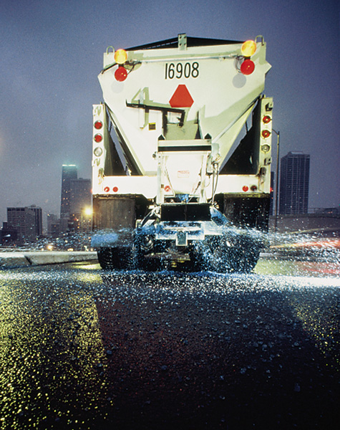
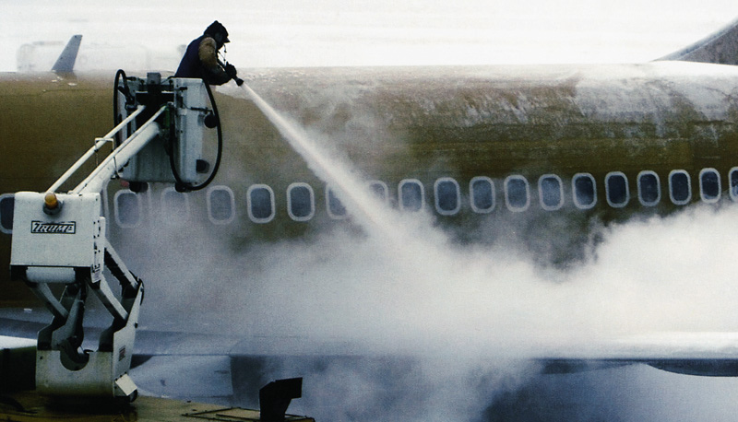
Practical Applications
Notes:
Ethylene glycol and CaCl₂ or NaCl

Slide 37
14-9 Solutions of Electrolytes
Svante Arrhenius
  Nobel Prize 1903.
  Ions form when electrolytes dissolve in solution.
  Explained anomalous colligative properties
Compare 0.0100 m aqueous urea to 0.0100 m NaCl (aq)
ΔT_{f} = -K_{f}  m = -1.86°C m⁻¹  0.0100 m = -0.0186°C
Freezing point depression for NaCl is -0.0361°C.

Slide 38
van’t Hoff
measured ΔT_{f}
0.0361°C
i = = = 1.98
expected ΔT_{f}
0.0186°C
π = -i  M  RT
ΔT_{f} = -i  K_{f}  m
ΔT_{b} = -i  K_{b}  m

Slide 39
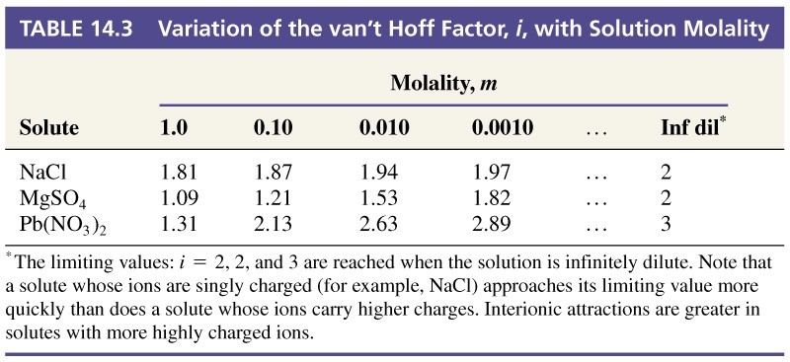
Interionic Interactions
Arrhenius theory does not correctly predict the conductivity of concentrated electrolytes.

Slide 40
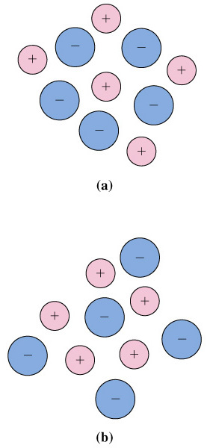
Debye and Hückel
1923
  Ions in solution do not behave independently.
  Each ion is surrounded by others of opposite charge.
  Ion mobility is reduced by the drag of the ionic atmosphere.

Slide 41
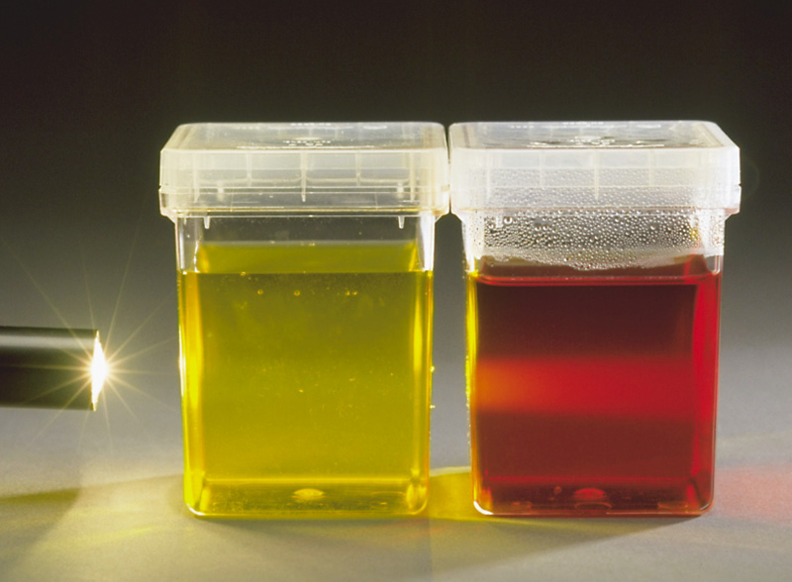
14-10 Colloidal Mixtures

Slide 42
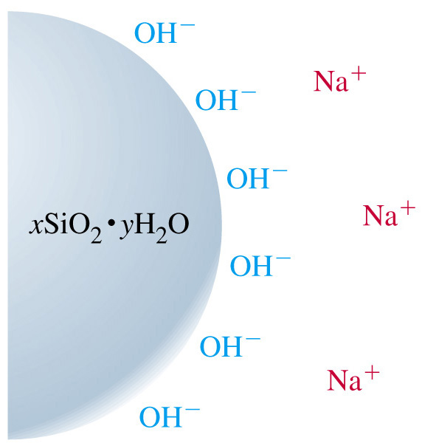
Colloids
Particles of 1-1000 nm size.
  Nanoparticles of various shapes: rods, discs, spheres.
  Particles can remain suspended indefinitly.
    Milk is colloidal.
Increasing ionic strength can cause precipitation.

Slide 43
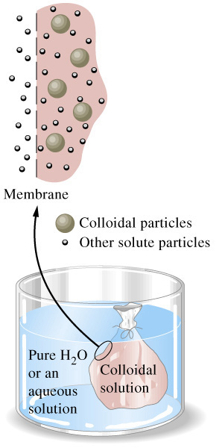
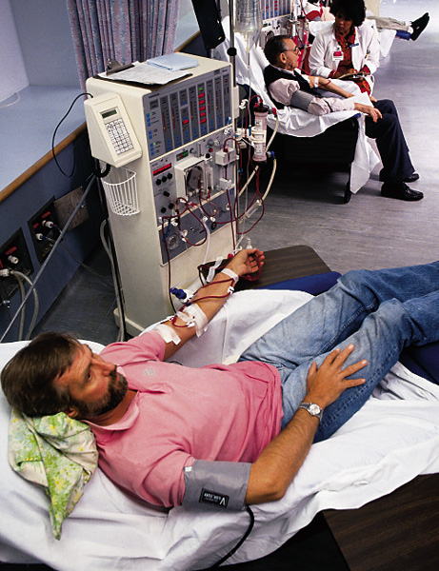
Dialysis

Slide 44
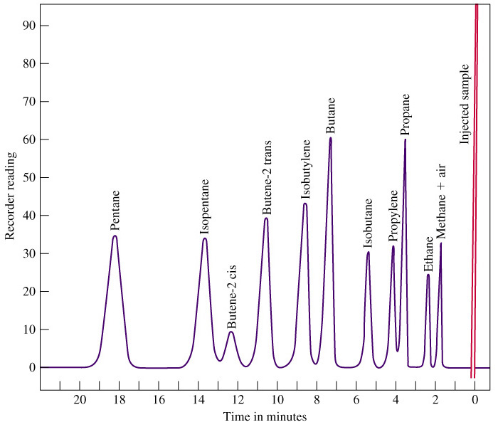
Focus on Chromatography
Stationary Phase
silicon gum
alumina
silica
Mobile Phase
solvent
gas

Slide 45
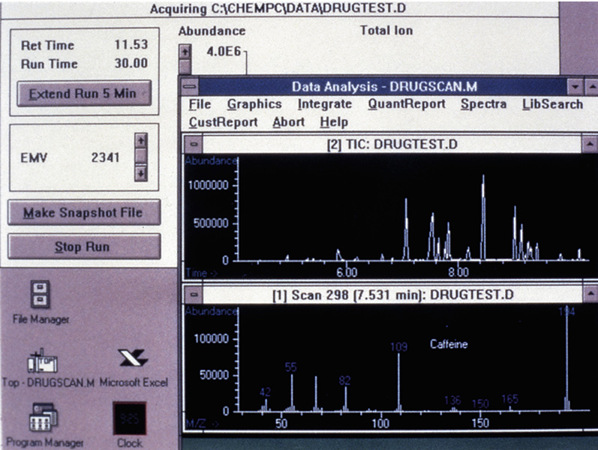
Chromatography

Slide 46
Chapter 14 Questions
Develop problem solving skills and base your strategy not on solutions to specific problems but on understanding.
Choose a variety of problems from the text as examples.
Practice good techniques and get coaching from people who have been here before.

